Slide 1
Writing and Analyzing Cases in Appropriate Technology
William J. Frey
Professor of Business Ethics
College of Business Administration
University of Puerto Rico at Mayaguez

Slide 2
Kant
Duty for Duty’s Sake
Action conforms to duty
Motive = duty
Do I (a physician) perform an appendectomy
Because I will get paid
Because it is my duty
Even though it is on my mortal enemy
Even when I am tired

Slide 3
Giving Content to Duty for Duty’s Sake
Categorical Imperative:
act only on that maxim (=personal rule or rule that I give to myself) that can be converted into a universal law (=a rule that applies to everybody without self-contradiction).
Do I copy my neighbor’s exam
Categorical Imperative becomes a self-defeating test
The circle of copying

Slide 4
Categorical Imperative: Step by Step
1. Formulate your maxim (=personal rule) | Whenever I am in a difficult situation, I can copy
2. Universalize your maxim (=universal law) | Whenever anybody is in a difficult situation, he or she should copy
3. Check for a contradiction (logical or practical) | If everybody is a copier, then there is nobody to copy from
Cheater wills one thing for him/her self and the opposite for everyone else

Slide 5
Formula of the End
I must treat you always as an end, never merely as a means
Treating as a means merely = circumventing someone’s autonomy
force, fraud (often deception), manipulation.
I invite you out on a date to dinner
Because I like you
Because I want to make my ex-girlfriend jealous
Because we can, together, make our ex-girl/ ex-boy friends jealous.
When do I treat you or someone else…
As an end? As a means? As a means merely?

Slide 6
Rights and Duties
1. A right is an essential capacity of action that others are obliged to recognize and respect.
2. A duty is a principle that obliges us to recognize and respect the autonomy of others (and of ourselves).
3. Correlativity: For every right there exists a series of duties that spell out how to recognize and respect the corresponding right
Duties not to deprive, prevent deprivation, aid the deprived
4. A right claim can be justified if it can be shown to be…
Essential to autonomy
Vulnerable to a standard threat
Does not deprive correlative duty-holder of something essential

Slide 7
A Right Claim
El derecho a la lealtad corporativa y la libertad de que sea hecho un chivo expiatorio para catástrofes naturales, ineptitud de administración u otras fuerzas mas allá del control del ingeniero.
Can this be simplified?
Is it essential to autonomy?
Is it vulnerable?
Is it feasible (are its correlative duties feasible?)

Slide 8
Rights and Duties
Vasanti was compelled to marry at a young age. In her caste, women are generally treated as property; she went from the family in which she was raised to the family of her husband. Like property, her husband was free to dispose of her as he saw fit. He beat her, forced her to work, and took the wages she earned through work and spent them on his leisure and on alcohol. In order to fund his alcohol habit, he had a vasectomy for which he received payment from the government. This ensured that he and Vasanti would not have children, something Vasanti wanted for her emotional fulfillment and economic security.

Slide 9
Does Vasanti have the right not to be treated as property?
How would this right be formulated? What does it include? (For example, does it include the right not to be beaten or the right to be protected from forced, conjugal sex?)
What essential capacities of action would this right protect?
Do women like Vasanti have this right even though they may not be aware of it due to what is termed "preference deformation?”

Slide 10
Rights and Duties
Jayamma carried bricks for a living in order to support her family. Although her work was harder than that performed by men she was paid less than them. When she became too old to continue with this arduous labor, she applied for relief. The Indian government denied her relief because she had sons who were able to support her. Yet her sons, for various reasons, were not willing to support her. Her daughter, who was willing to support her, was a registered nurse. Yet she was not able to practice because she could not pay the money necessary to bribe hospital officials to give her a job.

Slide 11
Does Jayamma have a right to fair pay and equal treatment in her employment?
Right to equality—equal treatment
Does this right exist in itself or must it be derived from another, more fundamental right?
If Jayamma has such a right, how can her society aid her as one who has been deprived of this right?
Do Jayamma’s sons have a duty to support her now that she is too old to work?
If so, to what right is this duty correlative?
Does Jayamma’s daughter have a right to work in the profession (nursing) for which she is qualified?
If so, what is the standard threat present in this situation that must be addressed to protect her right to work?
How are the duties correlative to this right to work to be spelled out and distributed?
What individuals have which level of correlative duty?
What organizations exist or could be devised to carry out some or all of the correlative duties?

Slide 12
From Rights and Duties…
To technology, technical artifacts, and appropriate technology

Slide 13
Vocabulary
Artifacts: objects that are not found in nature but are made, designed, and created by humans
Social Artifacts: “play a role in ruling the behavior of humans, their natural cooperation and the relationships between humans and social institutions” Vermaas 11
laws, government, state, marriage, driving license, traffic laws, currency (money), organizations (corporations), contracts (including social contracts)
Artistic artifacts: works of art created for enjoyment and beauty
Technical artifacts: “material objects that have been deliberately produced by humans in order to fulfill some kind of practical function.” Vermaas, 5
technical function
physical composition
instructions for use (use or user guide)
Technology: the knowledge and skill that goes into the making of technical artifacts
Applied science
Craft and skill (handed down from generation to generation)
Engineering?

Slide 14
Hypothesis 1
Society determines technology
SCOT argues that technologies pass through three stages: interpretive flexibility, closing of interpretive flexibility, and the emergence of the technical “black box.”
From Penny Farthing bicycle to modern design (based on Lawson bicycle)
Typewriter and the QWERTY keyboard
Pinch and Bijker (Social Construction of Technology)

Slide 15
Hypothesis 2
Technology determines society
Winner and Perrow
Complexity (manifest and latent)
tightly coupled systems—difficult to control because it is impossible to isolate failures
non-linear causality—effects of acts ripple throughout system; non-linearity makes it difficult to predict the consequences of actions
Reverse Adaptation
Because complex technologies redefine needs (and values), we are forced to adapt ourselves (and our needs) to them.
Technological Imperative
Technologies transform and redefine human needs. Machine needs become imperative and trump human needs.

Slide 16
Hypothesis 3
Technology and society influence one another.
A technical artifact is enrolled into a socio-technical system
The artifact is modified to fit the existing STS
But often, technical artifacts stimulate changes in the surrounding STS
Computers, cars, cell phones

Slide 17
Neutrality Thesis
“from a moral point of view a technical artifact is a neutral instrument that can only be put to good or bad use…used for morally good or bad ends, when it falls into the hands of human beings.” (Vermaas 16)
Guns don’t kill people; people kill people.
At stake—Who is responsible for harms produced by the use or abuse of technology: the user or the designer?

Slide 18
Value-Laden Thesis
Values can be designed into technical artifacts
Howe, Flanagan, Nissenbaum
Value Discovery, Value Translation (operationalization and implementation) and Value Verification
Value Sensitive Design
Oosterlaken: Zooming in and Zooming out
“Zooming in…allows us to see the specific features or design details of technical artifacts; zooming out…allows us to see how exactly technical artifacts are embedded in broader socio-technical networks and practices.”
Flanagan, Howe, and Nissenbaum, “Embodying Values in Technology” in Information Technology and Moral Philosophy, van den Hoven and Weckert.
(See Taking a Capability Approach to Technology and Its Design: A Philosophical Exploration, Introduction, 14. Simon Stevin Series in the Ethics of Technology). (See Taking a Critical Approach to Technology and Its Design 13 (table) and 14.)

Slide 19
The ontology of a technical artifact
Technical artifacts are relational; they must be understood in relation to different contexts
Social context: technical artifact must be unpacked in terms of the use-guide
Users can always develop procedures that circumvent (work around) the use-guide
STS:
Hardware, software, physical surroundings, people/groups/roles, procedures, laws (statutes and regulations), markets, information systems

Slide 20
Some criteria for appropriate technology
Ecologically sound
Low-cost
Low-maintenance
Labor intensive
Energy efficient
Simple, efficient, non-violent
Oosterlaken et al on Appropriate Technology
Conducive to decentralization
Compatible with laws of ecology
Makes use of modern knowledge
Gentle in the use of resources
Serves the human person
Production by the masses

Slide 21
From technology, technical artifacts, and appropriate technology to…
Socio-Technical Systems

Slide 22
1. Socio-Technical System
Socio-Technical System
“an intellectual tool to help us recognize patterns in the way technology is used and produced” (Huff, “What is a Socio-Technical System?” from Computing Cases)
Socio-Technical systems provide a tool to uncover the different environments in which business activity takes place and to articulate how these constrain and enable different business practices.

Slide 23
2. Socio-Technical System
A STS can be divided into different components such as hardware, software, physical surroundings, stakeholders, procedures, laws, and information systems.
These environments constrain and enable activities individually and collectively
Think about how the physical environment of the classroom embodies distinct pedagogical styles

Slide 24
3. Socio-Technical System
While different components can be distinguished these are inseparable. STSs are systems composed of interrelated and interacting parts.
“A system is a complex environment of interacting components, together with the networks of relationships among them, that identifies an entity or a set of processes.” (Werhane, Alleviating Global Poverty [21] referring to Laszlo & Krippner)
“Systems thinking is the habit of mind that considers any social entity as a complex interaction of individual and institutional actors each with conflicting interests and goals and with a number of feedback loops” (Werhane referring to Wolf 1999)

Slide 25
4. Socio-Technical System
STSs also embody values
moral values (justice, responsibility, respect, trust, and integrity)
non-moral values (efficiency, satisfaction, productivity, effectiveness, and profitability).
Often these values can be located in one or more of the system components.
These values conflict with one another causing the system to change.
Value vulnerabilities. Latent and Potential Harms

Slide 26
Value Realization (Again)
Values are designed into a STS through…
Discovery
Translation
Operationalization
Implementation
Verification
internal testing,
user testing in controlled environments,
formal and informal interviews and surveys,
prototypes,
traditional quality assurance measures
Flanagan, Howe, and Nissenbaum, “Embodying Values in Technology” in Information Technology and Moral Philosophy, van den Hoven and Weckert.

Slide 27
5. Socio-Technical System
STSs change and this change traces out a path or trajectory.
The normative challenge of STS analysis is to find the trajectory of STS change and work to make it as value positive and value-realizing as possible.

Slide 28
Example of a Socio-Technical System Table (ADMI 4016 in 236)
Technol-ogy | Software | Physical Surround-ngs | Stake-holders | Pro-cedures | Laws (univ regs) | Information systems
Classroom Computers Smart Board Data Display Projector Internet Connection | Microsoft Office (Social Networking Media) Google Documents Gantt Charts | Describe classroom and show how constrains interaction (Holding discussions with more than three) | Teacher, your group members, you, other teachers, other classmates Your boss (if you have a job outside of the univ) | Give one of your procedures for value realization Matricula (Does this procedure embody or frustrate justice?) | Rules on research misconduct Crazy Calendar (changing MWF to TTh; No exams in last week) | How your group assembles dispersed information Transferring information across STSs Informed Consent (providing info to others)

Slide 29
STS Summary
Socio-Technical systems provide a tool to uncover the different environments in which business activity takes place and to articulate how these constrain and enable different business practices
A STS can be divided into different components such as hardware, software, physical surroundings, stakeholders, procedures, laws, and information systems
But while different components can be distinguished these are, in the final analysis, inseparable. STSs are, first and foremost, systems composed of interrelated and interacting parts.
STSs also embody values such as moral values (justice, responsibility, respect, trust, and integrity) and non-moral values (efficiency, satisfaction, productivity, effectiveness, and profitability). Often these values can be located in one or more of the system components.
STSs change and this change traces out a path or trajectory. The normative challenge of STS analysis is to find the trajectory of STS change and work to make it as value positive and value realizing as possible.

Slide 30
Techno-Socio Sensitivity
Respon-sibility Skill | Description | Module | Activities
Techno-socio sensitivity Socio-Technical Systems in Professional Decision Making (m14025 from Connexions) Responsible Choice for Appropriate Technology (m43922) | “critical awareness of the way technology affects society and the way social forces in turn affect the evolution of technology” CE Harris, (2008), “The good engineer: Giving virtue its due in engineering ethics,” Science and Engineering Ethics, 14(2): 153-164. | Socio-technical Systems 1. Different environments constrain and enable activity. 2.System of distinguishable but interrelated and interacting parts. 3. Embody / express moral and non-moral values. 4. Normative objective = tracing out a value positive path or trajectory of change. | Identifying sub-environments How each constrains activity How each enables or instruments activity Value vulnerabilities and conflicts Plot out system trajectories or paths of change

Slide 31
Responsible Technological Choice
AT Case | Pivot to PR | Frameworks
One Laptop Per Child | Laptops to Teachers | Restore / Preserve interpretive flexibility Labor Intensive Simple De-centralized
Removing gender bias from airplane cockpit design | Removing social injustice from gas pipeline design
Uchangi Dam (eng as honest broker) | Engineers as Honest Brokers in PR Energy Debates
Amish (exercise of technological choice) | Vieques—Are windmills an appropriate or intermediate technology for Vieques? | Values in technology “fit” those embedded in STS
Aprovecho Case (NGO designs and tests wood-burning cooking stoves) | Are wood-burning stoves an appropriate technology? Is there a need for these stoves in PR? Would PR be a good regional center for testing stoves? | Technology serves as “conversion factor” in the conversion of capabilities into functionings
Waste for Life (Press that makes building materials out of waste products) | Using STS analysis to explain difference between Lesotho success and Buenos Aires failure

Slide 32
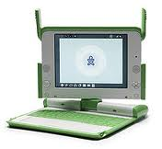
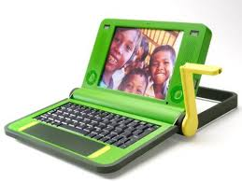
Responsive Technological Choice:
One Laptop Per Child
http://en.wikipedia.org/wiki/OLPC_XO-1
/
K. Kraemer, J. Dedrick, andP. Sharma
“One Laptop Per Child: vision vs. Reality”
Communications of the ACM 52(6): 66-73
http://en.wikipedia.org/wiki/OLPC_XO-1

Slide 33
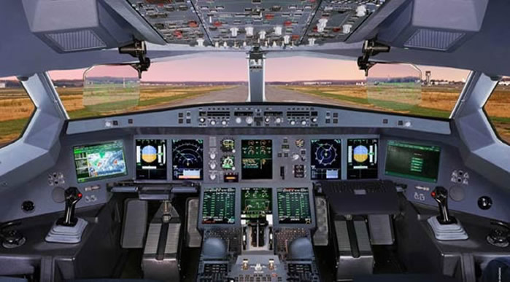
Responsive Technological Choice: Case 2
Redesigning airplane
cockpits to remove
gender bias
http://www.aviationexplorer.com/a350_facts.htm
Manufacturing Gender in Commercial and Military Cockpit Design Rachel N. Weber Science, Technology, & Human Values, Vol. 22, No. 2. (Spring, 1997), pp. 235-253.http://www.jstor.org Tue Jan 2 16:14:06 2007

Slide 34
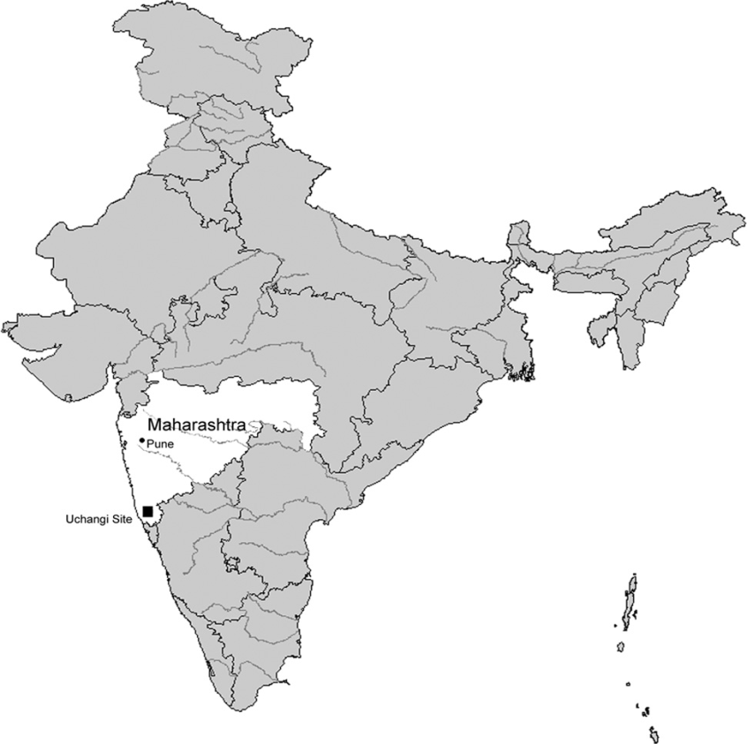
Responsive Technological Choice: Case 3
Bridging the gap between government and local
communities in the Uchangi Dam Project
How engineers and other professionals with
NGOs can serve as mediators or honest
brokers in disputes on technological choice
Professionals work with local
communities to “give them voice.”
Roopali Phadke. “People’s Science in Action: The Politics of Protest and Knowledge
Brokering in India.” In Tecnology and Society, Johnson and Wetmore eds. MIT Press, 2009, 499-513.

Slide 35
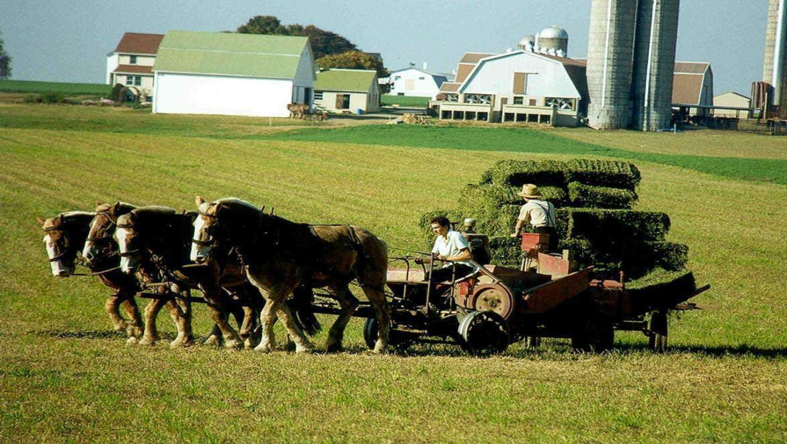
Responsive Technological Choice: Case 4
How the Amish adopt and adapt technology
Using technological choice to build a
community’s identity
Assessing how a technology would impact a
community’s core values
Modifying existing technology to minimize
negative impact on a community’s values
http://amishbeat.wordpress.com/
Jamison Wetmore. “Amish Technology: reinforcing Values and Building Community” in Technology and Society, eds. Johnson and Wetmore. 2009, MIT Press: 298-318

Slide 36
Choosing Your Topic
Tie to your areas of interest and research
Look for issues such as…
Community Development Project
Technical Devices (in the widest sense) being deployed
Underlying Social, Physical, and Historical Context
Topic should be supported with reliable, accessible information
Look for information on its socio-technical system
Topic should be interesting and engaging. The time you spend preparing it should be time well spent.

Slide 37
1. Provide an Executive Summary
Acquaint the reader with highlights of your appropriate technology, the socio-technical system in which it functions, whether it is appropriate, and how it stands with human capabilities

Slide 38
2. Zoom in on your case’s main technical artifact
Classify the artifact
Social
Artistic
Technical
Describe its physical characteristics and how its parts fit together
Outline what the artifact is doing when it is functioning as it was designed to function
Are there any “work arounds” that is functionings that were discovered after the product left the designer’s laboratory?
Provide user instructions that help users deploy the technical artifact or release it for its proper functioning

Slide 39
3. Zoom out by describing the socio-technical system
Identify the key sub-environments like…
Hardware, software, physical surroundings, people/groups/roles, procedures, laws, information systems
How do these constrain the functioning of the artifact?
How do these enable the functioning of the artifact?
Prepare a socio-technical system to summarize the results of your STS description
What is the trajectory of the STS? Is it value positive or negative?

Slide 40
Like this one…
Technol-ogy | Software | Physical Surround-ngs | Stake-holders | Pro-cedures | Laws (univ regs) | Information systems
Classroom Computers Smart Board Data Display Projector Internet Connection | Microsoft Office (Social Networking Media) Google Documents Gantt Charts | Describe classroom and show how constrains interaction (Holding discussions with more than three) | Teacher, your group members, you, other teachers, other classmates Your boss (if you have a job outside of the univ) | Give one of your procedures for value realization Matricula (Does this procedure embody or frustrate justice?) | Rules on research misconduct Crazy Calendar (changing MWF to TTh; No exams in last week) | How your group assembles dispersed information Transferring information across STSs Informed Consent (providing info to others)

Slide 41
4. Discuss your technology and case using criteria of appropriate technology such as…
Ecologically sound
Low-cost
Low-maintenance
Labor intensive
Energy efficient
Simple, efficient, non-violent
Oosterlaken et al on Appropriate Technology
Conducive to decentralization
Compatible with laws of ecology
Makes use of modern knowledge
Gentle in the use of resources
Serves the human person
Production by the masses

Slide 42
5. Evaluate your technology using the Capability Approach
Does your technical artifact serve as a conversion factor that helps individuals turn capabilities into functionings?
What environmental/STS features stand in the way of the realization of the capabilities you have chosen?
Is your technical artifact a personal, social, or environmental conversion factor?

Slide 43
Types of Capabilities
Basic Capabilities
Life
Bodily health
Bodily integrity
Cognitive Capabilities
Senses / imagination / thought
Emotions (“not having one’s emotional development blighted by fear and anxiety”)
practical reason (liberty of conscience and religious observance)

Slide 44
Types of Capabilities
Social or Out-reaching Capabilities
Affiliations
“live with and toward others, to recognize and show concern for other human beings, to engage in various forms of social interaction; to be able to imagine the situation of another(freedom of assembly and speech)
“Having the social bases of self-respect and nonhumiliation; being able to be treated as a dignified being whose worth is equal to that of others (nondiscrimination)
Other Species
“Being able to live with concern for and in relation to animals, plants, and the world of nature.”

Slide 45
Types of Capabilities
Agent Capabilities
Play
Control over one’s environment
“Political.
Being able to participate effectively in political choices that govern one’s life; having the right of political participation, protections of free speech and association.”
Material.
Being able to hold property (both land and movable goods), and having property rights on an equal basis with others;
having the right to seek employment on an equal basis with others;
having the freedom from unwarranted search and seizure.
In work being able to work as a human being, exercising practical reason and entering into meaningful relationships of mutual recognition with other workers

Slide 46
Conversion Factors
Means that realize capabilities into functionings
Resources, tools, technologies
Personal
Metabolism, physical condition, sex, reading skills, gender, race, caste
Social
Public policies, social norms, practices that unfairly discriminate, societal hierarchies, power relations related to class or gender, race, caste.
Environmental
Physical or built environment, climate, pollution, proneness to earthquakes, presence or absence of seas or oceans Ingrid Robeyns, "The Capability Approach", The Stanford Encyclopedia of Philosophy (Summer 2011), Edward N. Zalta (ed.)

Slide 47
6. Develop a poster (electronic) on your case for presenting to the class
Summarize the previous steps in a poster
Encapsulate your STS description in a table
Summarize strategically and use images to get your point across
Make it a conversation, not a presentation.

Slide 48
7. Import your report into Connexions for publication
Create a module in our workgroup
Import your report and add your poster presentation as a media file
Assign and allocate authoring roles
Check and decide whether to consent to authoring roles and Creative Commons attribution license
Publish a version of your report that is “friendly” to undergraduate students; mentor them on your case and research

Slide 49
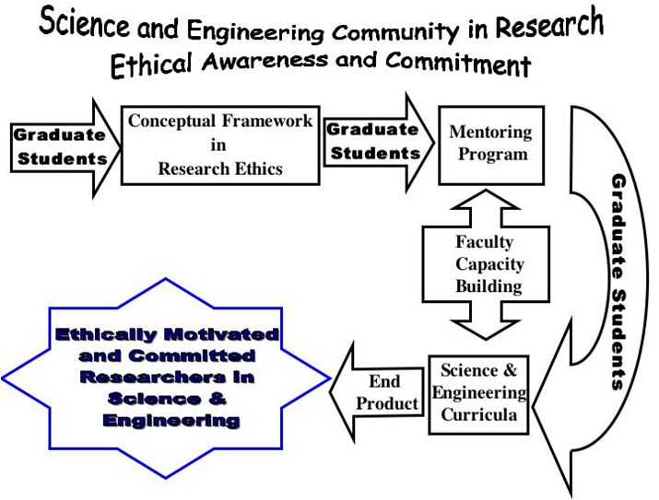
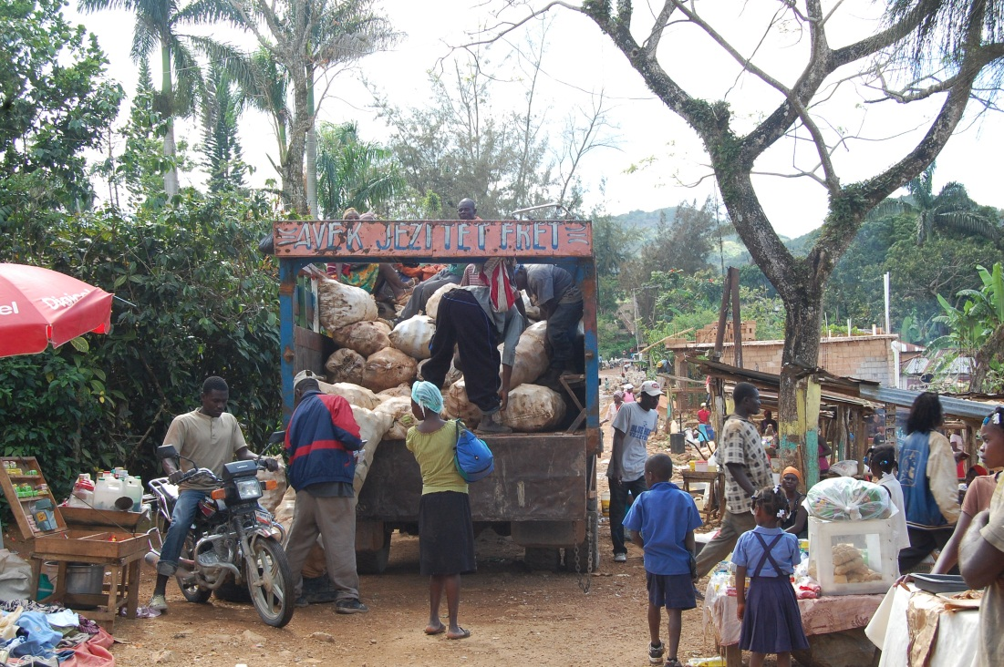


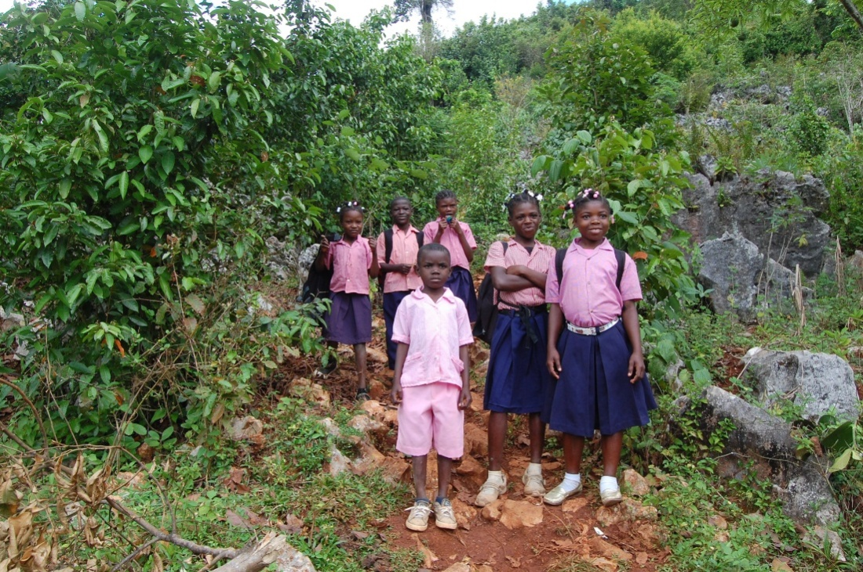
Thank-You
William J. Frey, College of Business Administration, University of Puerto Rico at Mayaguez
Moral Imagination
Realizing capabilities
Understanding Moral Expertise
Developing profitable partnerships
to alleviate poverty

